Slide 1
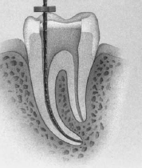
WORKING LENGTH DETERMINATION

Slide 2
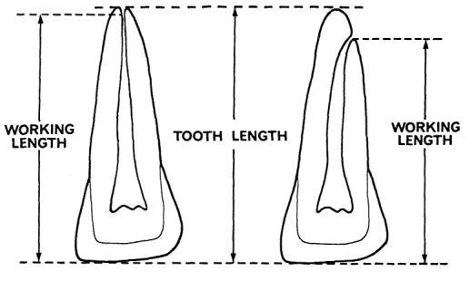
DEFINITION
WORKING LENGTH
“The distance from the coronal reference point to the point at which canal preparation and obturation should terminate”.
ENDOMETRY
Refers to the accurate determination of the WL, which decides the apical termination point for all intra canal procedures from a reference point

Slide 3
SIGNIFICANCE
Determines how far into the canal debris, metabolites, end products and other unwanted items are removed.
1
Determines how far into the canal the instruments are placed. worked.
2
3
If calculated correctly, helps in determining the success of treatment.
4
It effects the degree of pain and discomfort the patient feels.

Slide 4
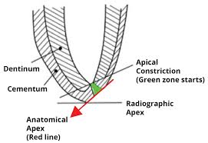
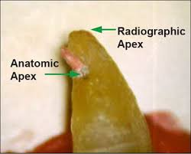
APICAL LIMIT OF THE ROOT CANAL SYSTEM
1. ROOT APEX
Anatomic apex : Is the tip / the end of the root determined morphologically
Radiographic apex : Is the tip /end of the root determined radiographically
Histological apex – It is represented by the CEJ

Slide 5
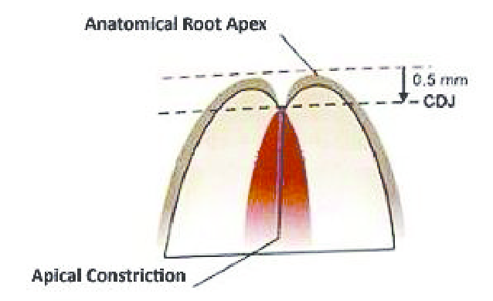
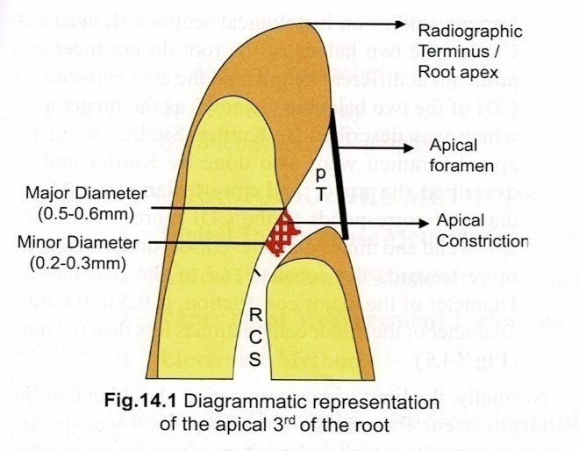
2. APICAL FORAMEN
Histological , it is the area where blood vessels & nerve plexus enter the tooth , but not seen radio graphically
3.APICAL CONSTRICTION
It is the region where the CDJ of the two halves of the root meet – known as TARGET AREA
Diameter of – major constriction – 0.5 to 0.6mm
Diameter of the minor constriction – less than 0.2mm
Target area ranges – 0.75- 1mm , & it varies with the age of the patient – as age increases , cementum deposition increases - distance between the target area & the root apex increases
Main objective is to determine the distance from the target area to the coronal reference point

Slide 6
NEED FOR DETERMINING WORKING LENGTH
Optimal length of canal preparation & Optimal level of canal obturation is the apical constriction , - narrowest part of the canal & a morphologic land mark – helps to improve apical seal
Exact WL is determined by adjusting the length of insertion , so that the tip of the instrument ends 0.5 mm from the root apex

Slide 7
FAILURE TO ACCURATELY DETERMINE & MAINTAIN WORKING LENGTH LEADS TO
perforation through apical foramina,
post operative pain ,
prolong healing period – leads to over filling / over extension
Working long-
Defined as that which has been extended beyond the confines of the root canal system but fills the canal system ( voids & porosities )
Leads
Lower success rate owing to incomplete regeneration of – cementum , PDL & alv bone

Slide 8
Working short -
Incomplete cleaning
persistent discomfort as the pulpal remnants are left behind
Under filling
Incomplete apical seal
Apical leakage
Lower success

Slide 9
Loss of working length – occurs due to
Straightening of curved canal
Accumulation of dentinal & pulpal debris in apical 2-3 mm of the canal
Failing to maintain foramen patency
Skipping instrument sizes
Failing to irrigate the apical 1/3rd
Ledge formation
Instrument separation
Blockage of the canal
Measurement should be made from a secure reference point on the crown, that can be identified & monitored accurately , in close proximity to the straight line part of the instrument

Slide 10
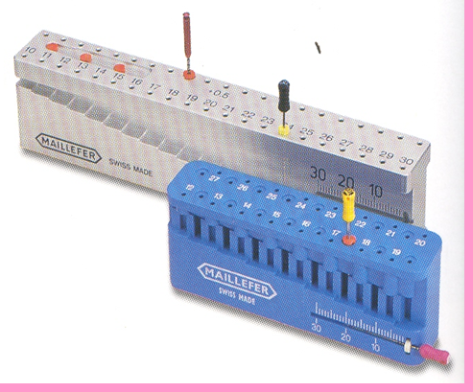

Measuring block
Length adjustment of the stop made against the edge of a sterile metric ruler / a gauge specific for endodontics
Eg- Guidener endo –M- Block
Has 32 depth guides in 2rows
Front row indicates from 12-27mm in 1mm increments
Back row indicates 0.5mm deeper
Half full ruler at the end

Slide 11
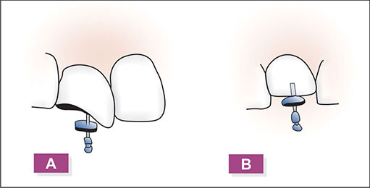
REFERENCE POINT
The point from which the WL is measured ie., stopper used on the incisal edges – anteriors & cavo surface cusp tips of molars
2 types
Coronal
Apical
Point at which canal preparation & obturation should terminate
Anterior teeth – incisal edge
Posterior teeth – cusp tips
American Association of Endodontists, Glossary of Endodontic Terms, 7th edition, 2003.

Slide 12
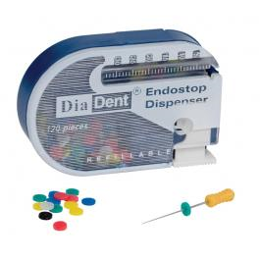
STOP ATTACHMENTS
Most popular & commonly used – silicon rubber stops
2 shapes
Tear drop
Round
Advantages of silicon rubber stops
Advantages of tear drop shaped rubber stoppers
Need not be removed during sterilization
Radiopaque, - identified on the radiograph
Low thermal conductivity – doesn’t cause injury to the soft tissues
Curved canals – it indicates the canal curvature as the special tear shaped can be positioned with the direction of the curve

Slide 13
AVERAGE LENGTH OF TEETH
 | Maxillary (mm) | Mandibular (mm)
Central Incisor | 23 | 20.5
Lateral Incisor | 22 | 21
Cuspids | 26.5 | 25.5
First Premolar | 20.5 | 20.5
Second Premolar | 21.5 | 22
First Molar | 20.5 | 21
Second Molar | 20 | 20

Slide 14
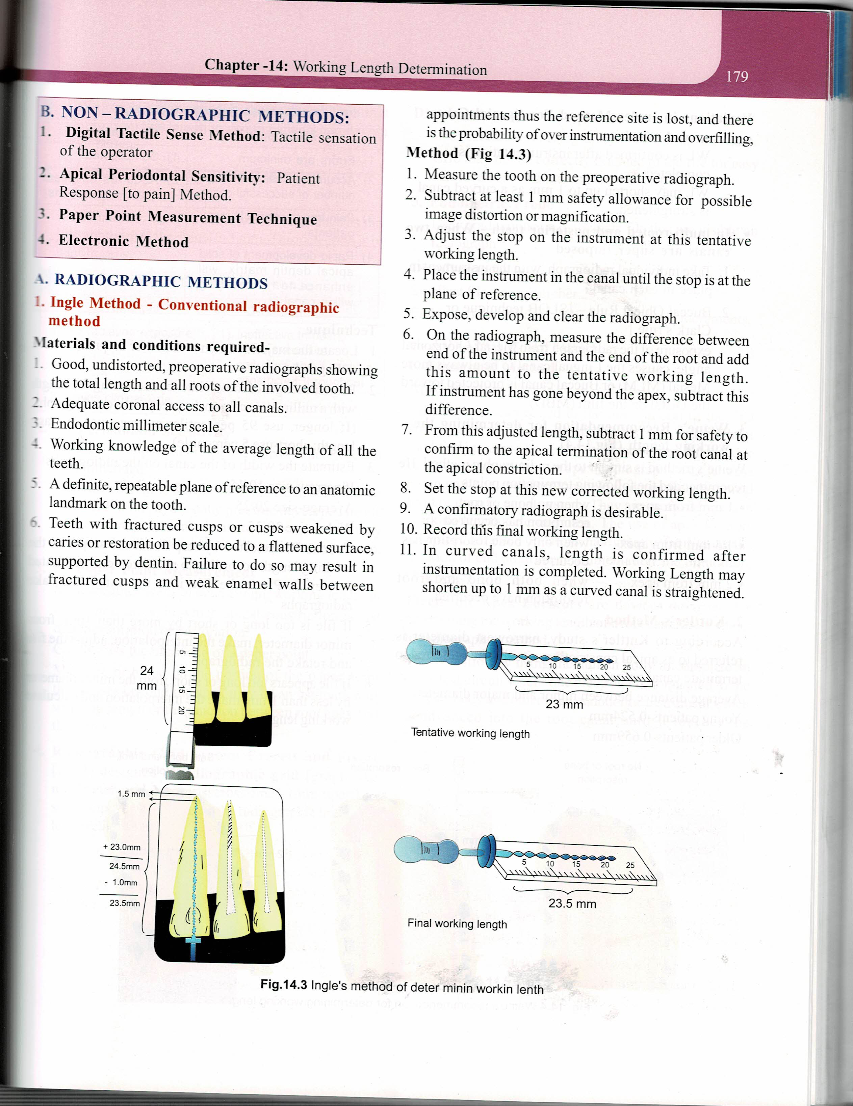
METHODS OF DETERMINING WORKING LENGTH

Slide 15
TECHNIQUES FOR WORKING LENGTH DETERMINATION
Radiographic Methods
GROSSMAN’S METHOD
- Original diagnostic radiograph is measured from occlusal surface to root apex.
- This length is verified by inserting instrument to estimated W.L in canal and taking an instrumentation radiograph.
Actual length of tooth =
Actual length of Radiograph Χ Instrument Length of tooth
Radiographic length of instrument

Slide 16
WL DETERMINATION IN A MULTI ROOTED TOOTH
Done for each root canal
For e.g., - Mn molars – mesial root – 2 canals – if both are over lapping , - k –type file is inserted in one canal & H –type file in other canal & radiographs at 20 to 40 degree mesial / distal horizontal angulation are taken to view all the canals

Slide 17
INGLE METHOD – CONVENTIONAL RADIOGRAPHIC METHOD
Materials & conditions required
Good , undistorted , preoperative radiographs showing the total length & all roots of the involved tooth
Adequate coronal access to all canals
Endodontic millimeter scale
Working knowledge of the average length of all the teeth
A definite , repeatable plane of reference to an anatomic landmark on the tooth

Slide 18
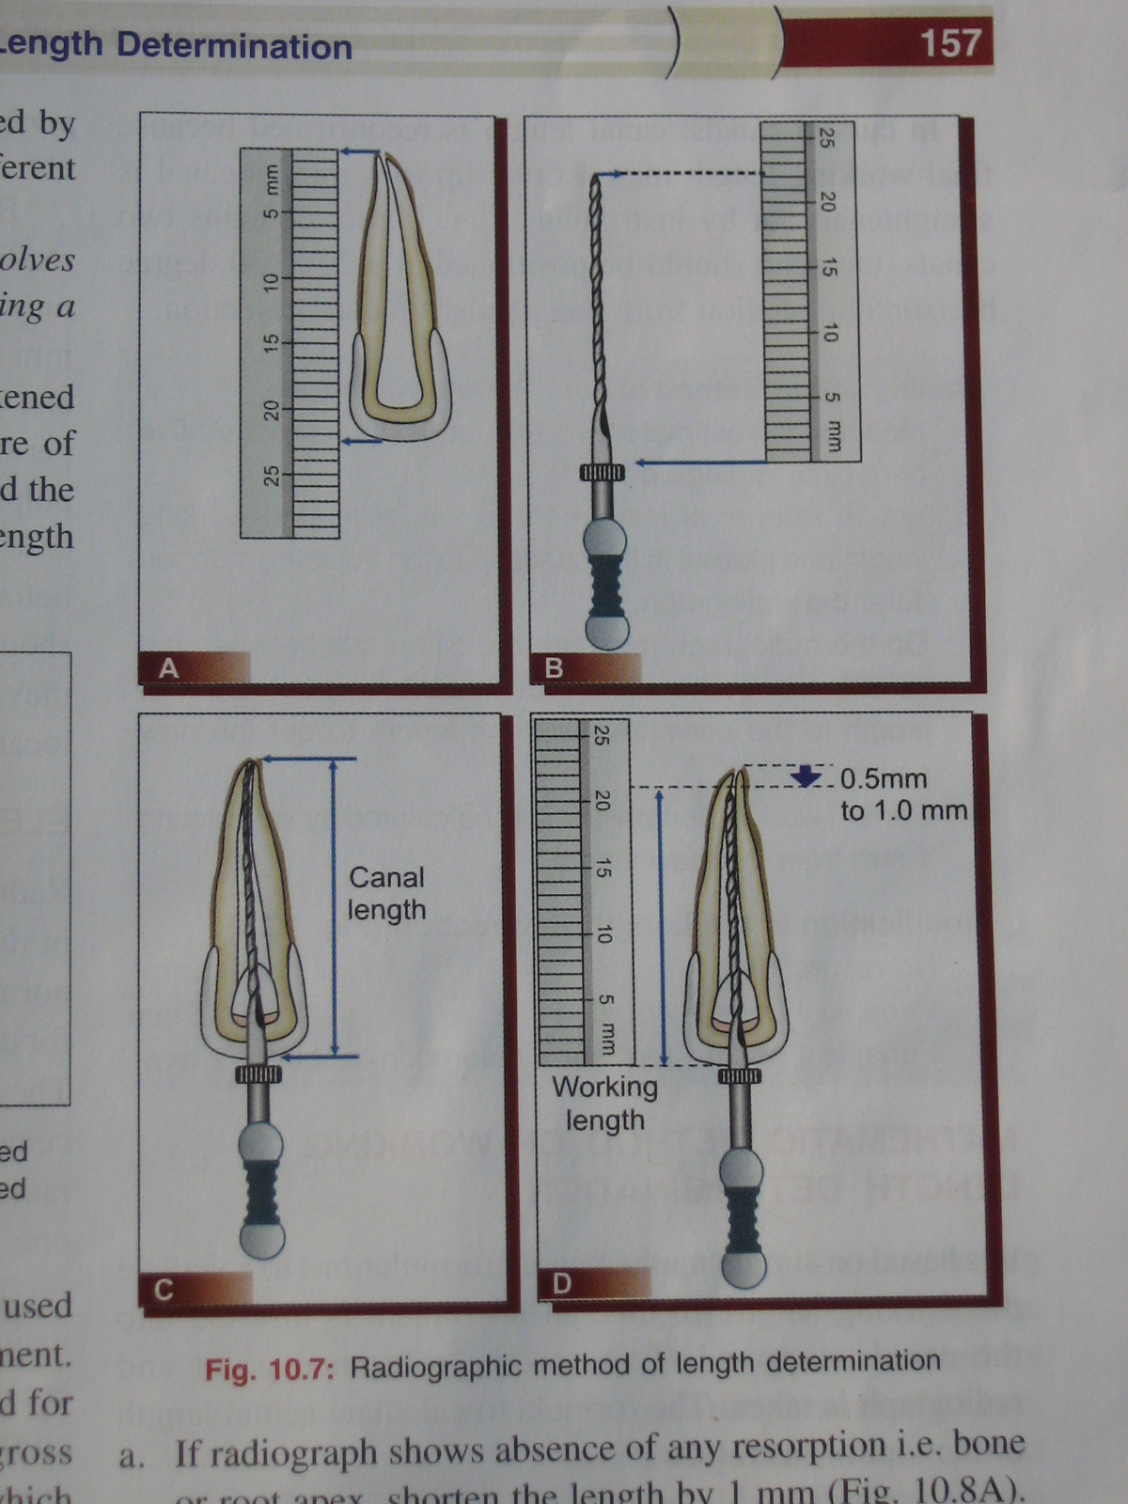
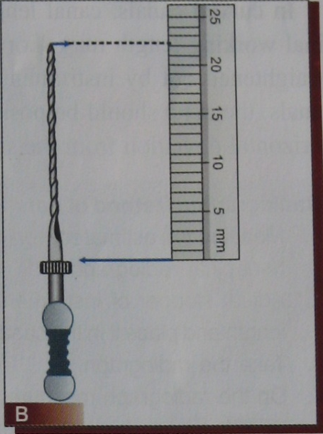
METHOD
Measure the tooth on the preoperative radiograph
Subtract at least 1.0mm “safety allowance” for possible image distortion or magnification
Set the endodontic ruler & adjust the stop on the instrument at that level

Slide 19
Place the instrument in the canal until the stop is at the plane of reference unless pain is felt, in which case, the instrument is left at that level & the rubber stop is readjusted to this new point of reference
Expose, develop & clear the radiograph

Slide 20
On radiograph, measure the difference b/n the end of the instrument & end of the root

Slide 21
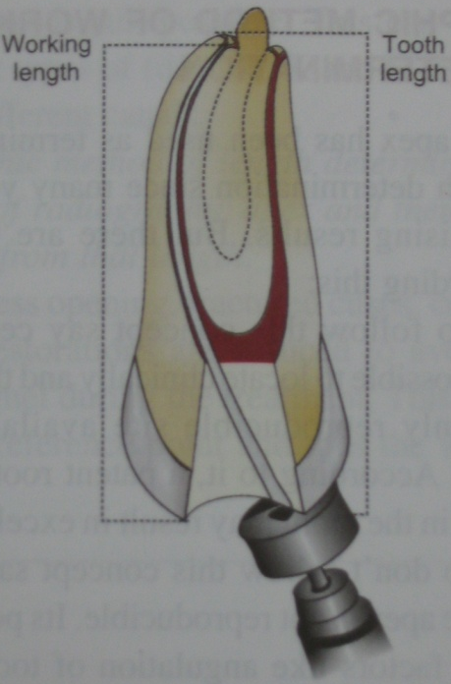
From the adjusted length of tooth, subtract 1.0 mm “safety factor” – to conform with the apical termination of the root at apical constriction
New corrected length & readjust the stop on the exploring instrument

Slide 22
Because possibility of radiographic distortion, sharply curving roots, & operator measuring error, a confirmatory radiograph of the adjusted length is highly desirable
When the length of the tooth has been accurately confirmed, reset the endodontic ruler at this measurement
Record final WL and the coronal point of reference on the pt’s record
Length of the tooth in a curved canal be reconfirmed after instrumentation is completed
curved canal is straightened out by instrumentation

Slide 23
Variations in Ingles method for special cases
WL – confirmed after instrumentation is completed
WL – may shorten up to 1mm as a curved canal is straightened
IN CURVED CANALS
Take individual radiograph , with instrument in place in each canal
Buccal Object Rule – ( SLOB technique / Clarks rule )
Exposure of the radiograph from mesial – horizontal angle , causes the lingual canal to be always more mesial (MLM) / Buccal canal is projected toward the Distal on the film (MBD)
MULTI-ROOTED & POSTERIOR TEETH – WHEN 2 CANALS – SUPER IMPOSED

Slide 24
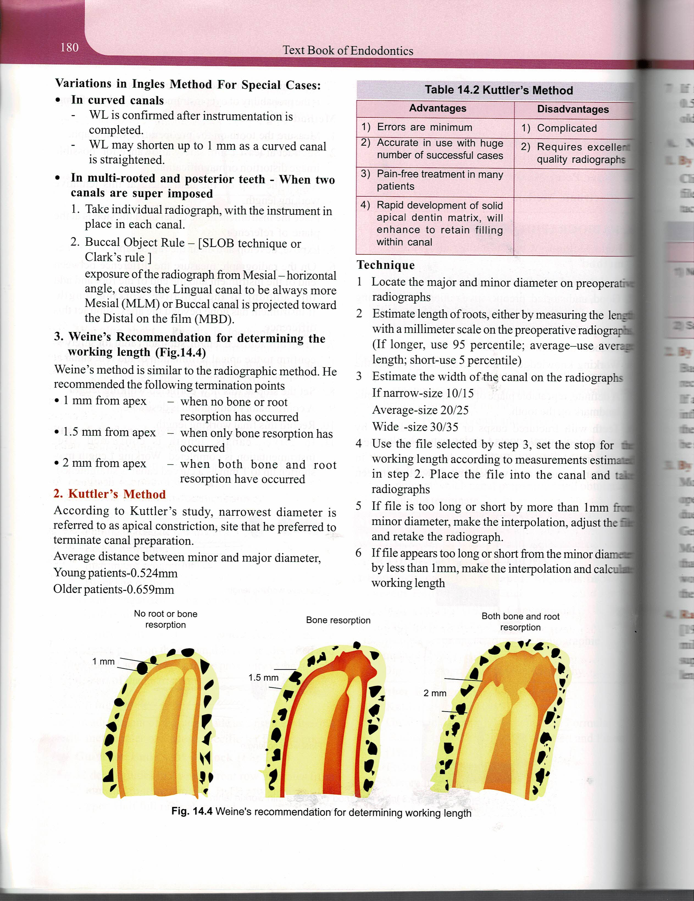
Weine’s recommendation for determining the WL

Slide 25
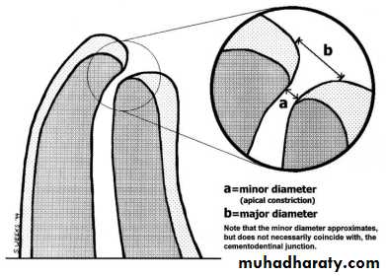
KUTTLER’S METHOD
Narrowest diameter is referred to as apical constriction, site that he preferred to terminate canal preparation.
Average distance between minor & major diameter
Young patients-0.524 mm
Older patients-0.659 mm

Slide 26
TECHNIQUE
Locate the major & minor diameter on pre operative radiographs
Estimate length of roots - measuring the length with a mm scale on the preoperative radiographs
Estimate the width of the canal on the radiograghs – narrow –size 10/15, average –size 20/25, wide –size 30/35
Use the file selected , set a stop for WL - take a radiograph
If file is too long / short by more than 1mm from minor diameter, make interpolation , adjust the file & retake the radiograph
If the file appears too long / short from the minor diameter by less than 1mm , make the interpolation & calculate the WL

Slide 28
BREGMAN METHOD
- Flat probes, 25mm. in length, are prepared.
- Steel blade fixed with acrylic resin as stop, leaving free segment of 10mm for placement into root canal.
CRD = CRI × CAD
CAI
CRD = Real tooth length
CAD = Apparent tooth length, seen in radiograph.
CRI = Real instrument length.
CAI = Apparent instrument length, seen in radiograph.

Slide 29
BEST’S METHOD
A 10mm steel pin is fixed to labial surface of tooth with utility wax in position parallel to its long axis before radiograph obtained.
Radiograph is then carried to gauge that indicates tooth length.
Generally presents lengths greater than real length of teeth.

Slide 30
DIGITAL RADIOGRAPHY
Digital image is a image found & represented by a spatially distributed set of discrete sensors & pixels
E .g., Radio Visio Graphy

Slide 31
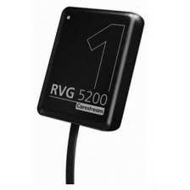
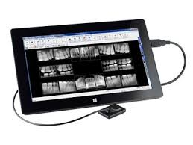
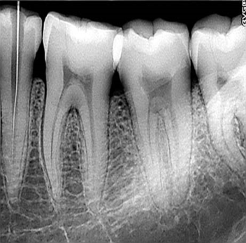
A) RADIOVISIOGRAPHY (RVG)
Components of RVG
The “Radio” component x ray unit: Consists of a hypersensitive intra oral sensor and a conventional
x-ray unit.
The “Visio” portion: Consists of a video monitor and display processing unit
“Graphy “ portion – storage module that can be connected to a final image display

Slide 32
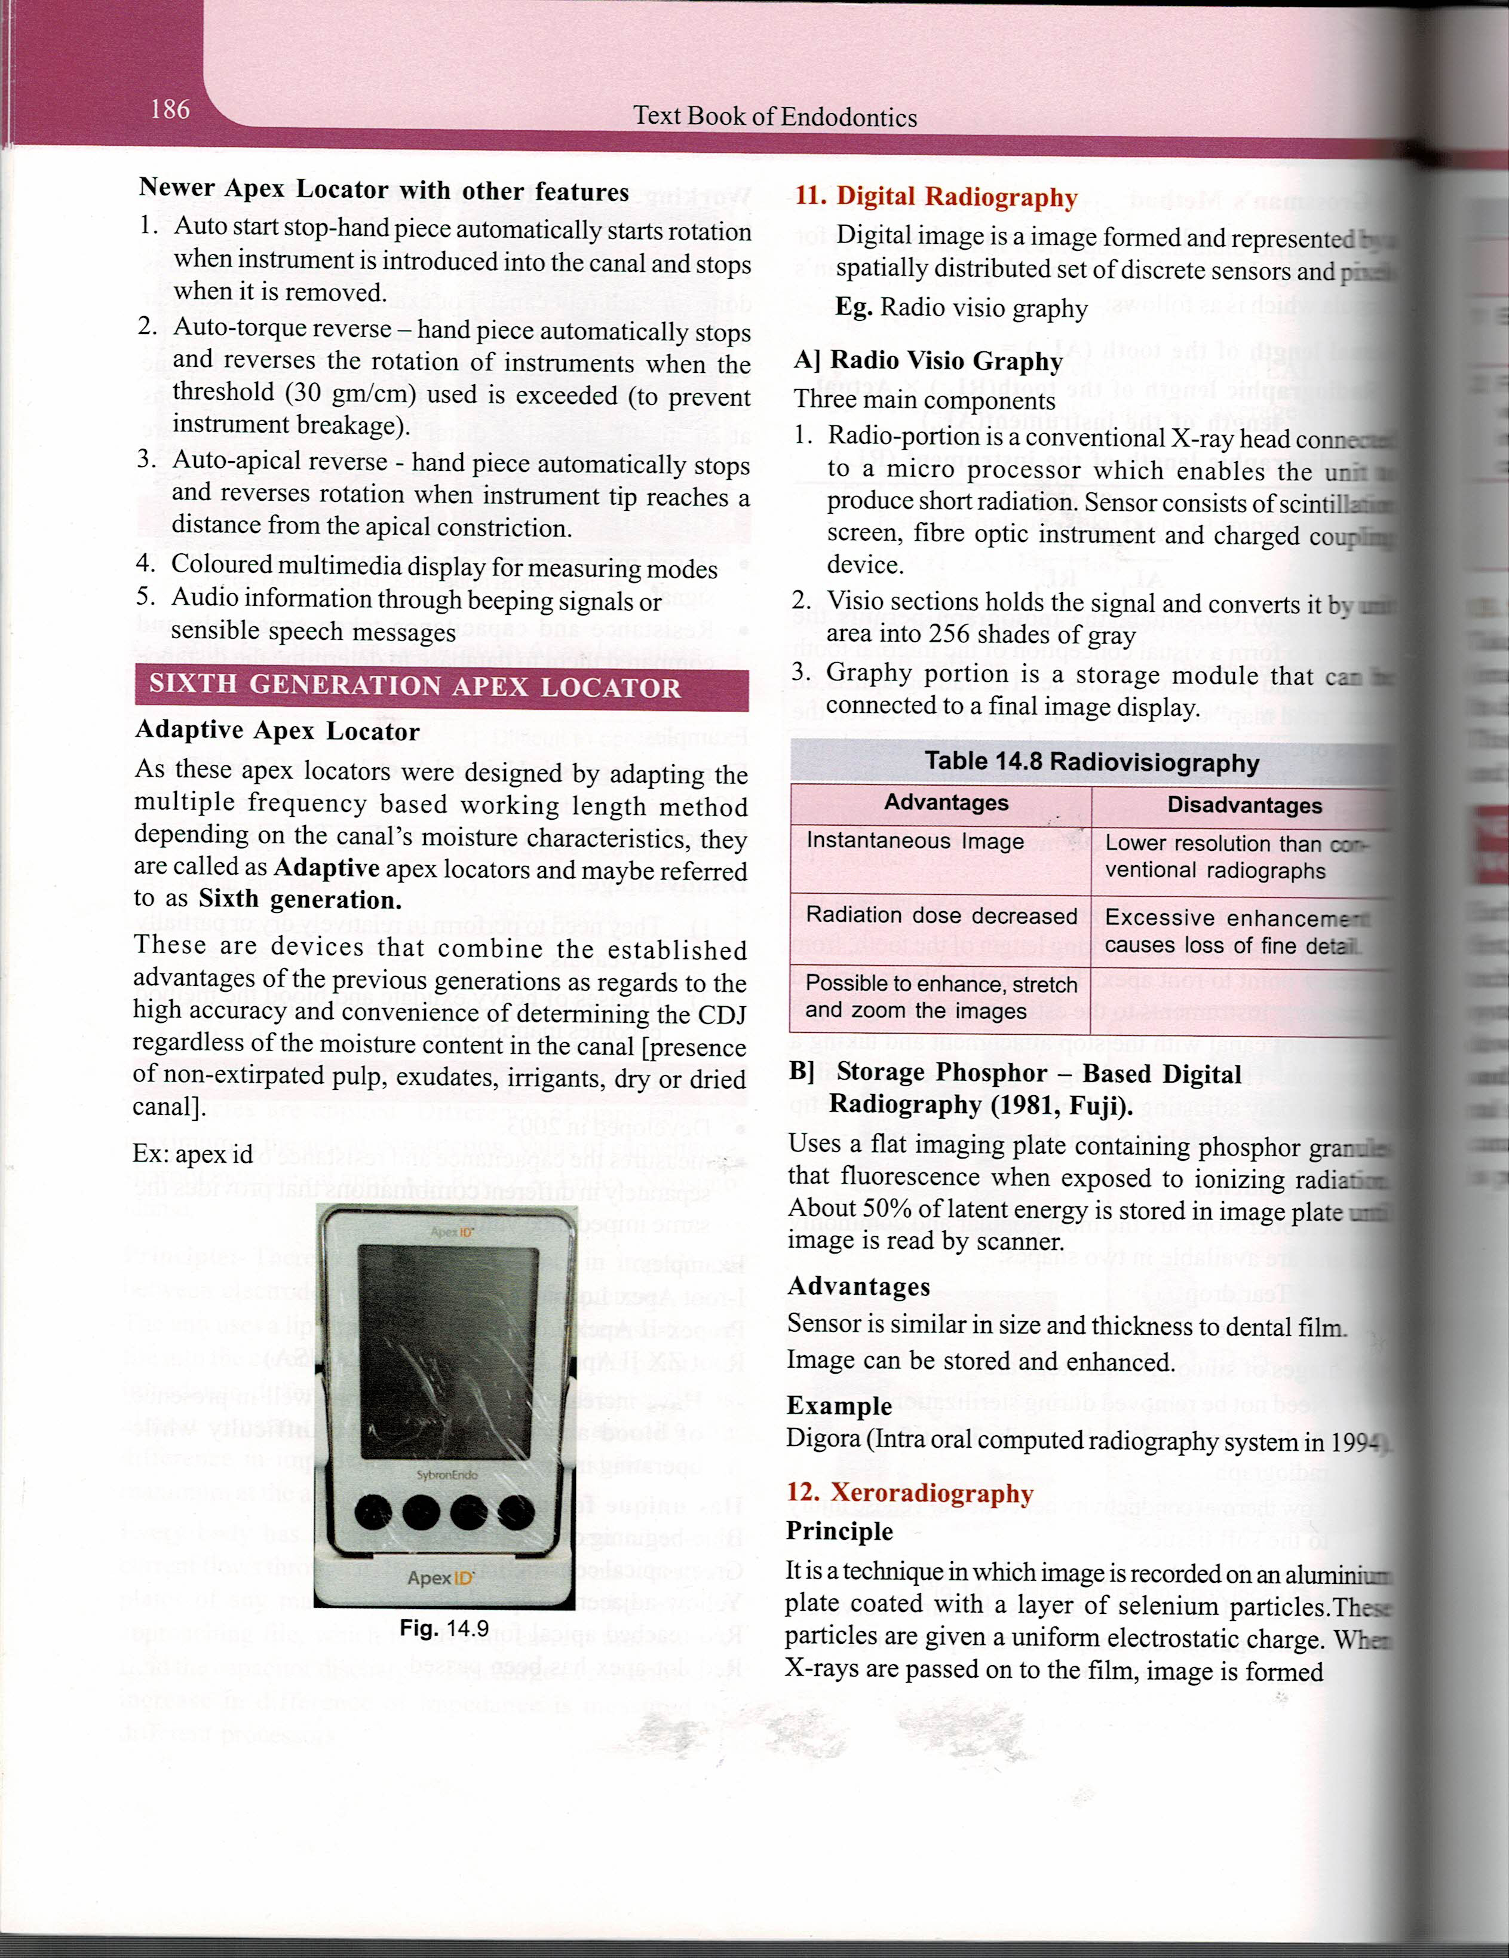

Slide 33
B) STORAGE PHOSPHOR – Based Digital Radiography ( 1981, FUJI)
Uses a flat imaging plate containing phosphor granules that fluorescence when exposed to ionizing radiation
50% of latent energy is stored in image plate until image is read by scanner
ADVANTAGES
Sensor is similar in size & thickness to dental film
Image cab be stored & enhanced
EXAMPLE- Digora( intra oral computed radiography system in 1994

Slide 34
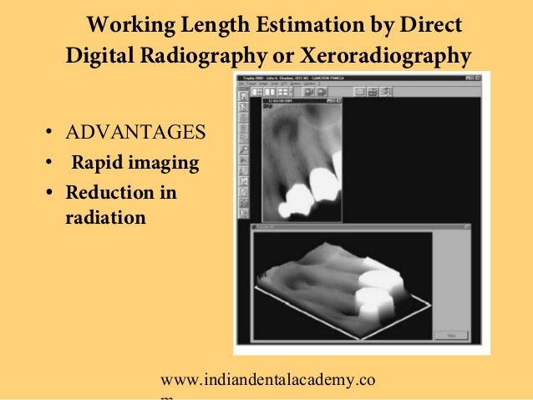
XERORADIOGRAPHY
Technique – image is recorded on a aluminum plate coated with a layer of selenium particles
These particles are given a uniform electro static charge
When x-rays are passed on to the film , image is formed

Slide 35
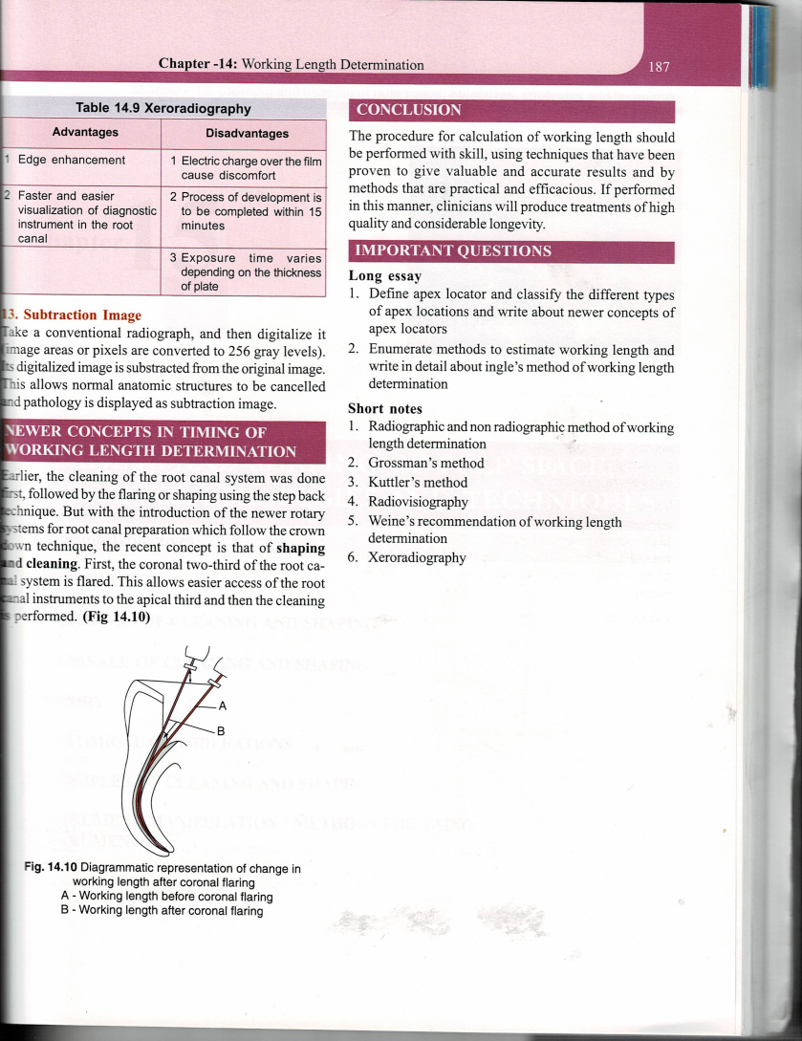

Slide 36
SUBTRACTION IMAGE
Take a conventional radiograph, & then digitalize it ( image areas / pixels are converted to 256 gray levels )
Its digitalized image is subtracted from the original image
This allows normal anatomic structures to be cancelled & pathology is displayed as subtraction image

Slide 37
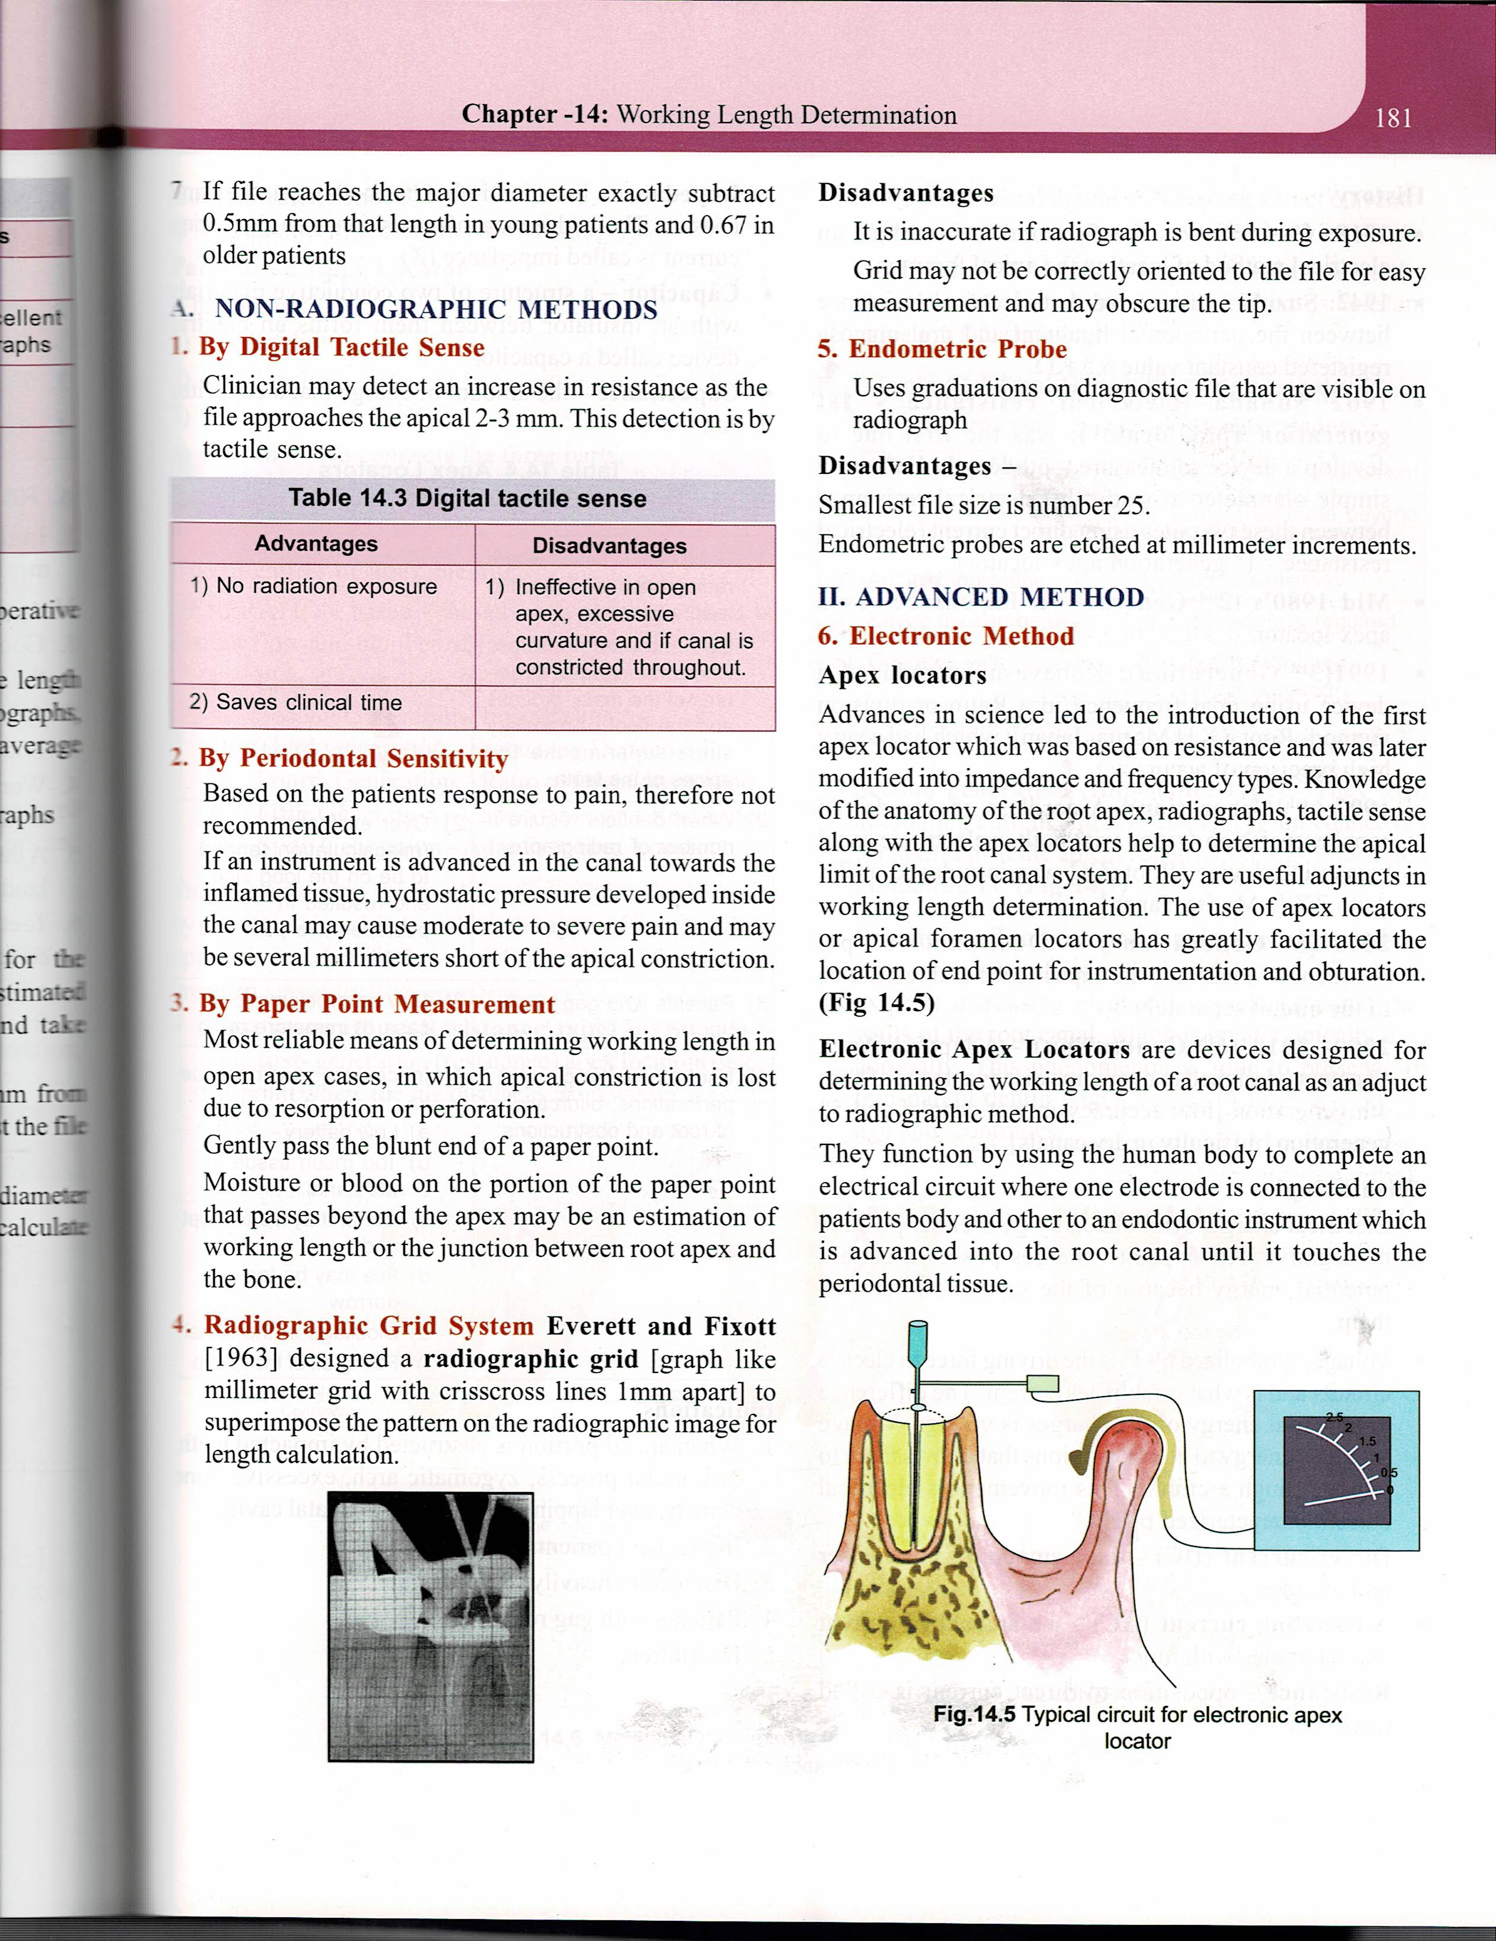
Non Radiographic Methods
Tactile Sensation
Teeth possess apical constriction due to presence of apical resorption.
Ability to gauge apical constriction relies on presence of natural canal taper that has minimal constriction only at termination of canal.
Ineffective in root canals with an immature apex.

Slide 38
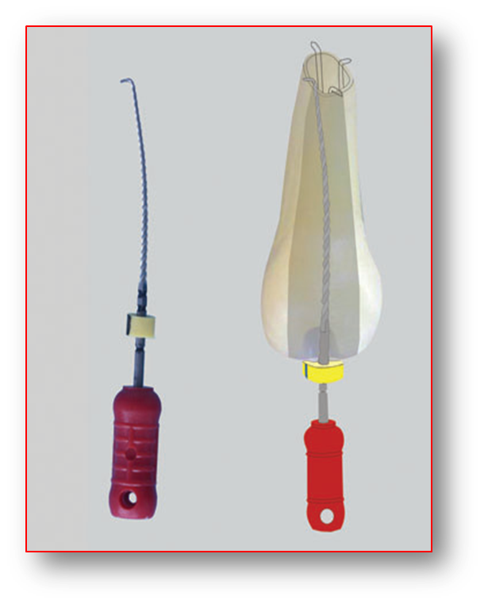
Apical Periodontal Sensitivity
. Based on patients response, dentists observe ‘eye twitching’ sign
Always working length determinants should be painless.
In inflamed tissue, hydrostatic pressure developed may cause moderate to severe instantaneous pain.

Slide 39
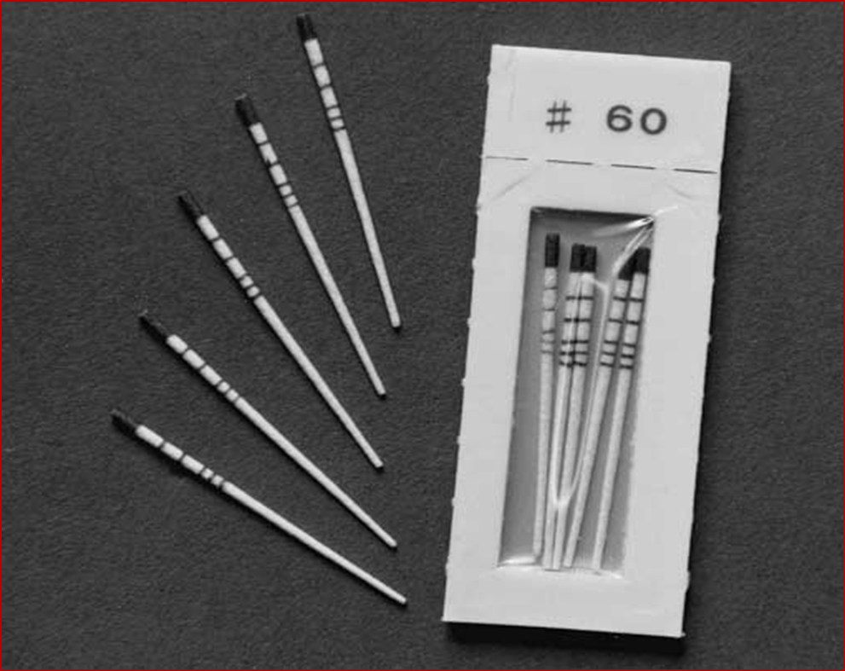
Paper point method
In root canal with immature apex.
The moisture (or) blood on portion on portion of paper point that passes beyond apex may be an estimation of working length (or) junction between root apex and bone.

Slide 40
Radiographic grid system
Everett & fixott- 1963
Graph like mm grid with crisscross lines 1mm apart
Superimpose the pattern on the radiographic image for length calculation

Slide 41
Endometric probe
Uses graduations on diagnostic file that are visible on radiograph

Slide 42

II. ADVANCED METHODS ELECTRONIC METHOD -apex locators
Devices designed for determining the WL of a root canal as an adjunct to radiographic method

Slide 43

Basic Functions of EAL’S
All apex locator’s function by using human body to complete an electrical circuit one side of apex locator’s circuitry is connected to an endodontic instrument.
Other side is connected to patient’s body; either by contact to patient’s lip (or) by electrode in patients hand.
Electrical circuit is complete when endodontic instrument is advanced apically inside root canal touches PDL.
Display on apex locator indicates that apical area has been reached.

Slide 44
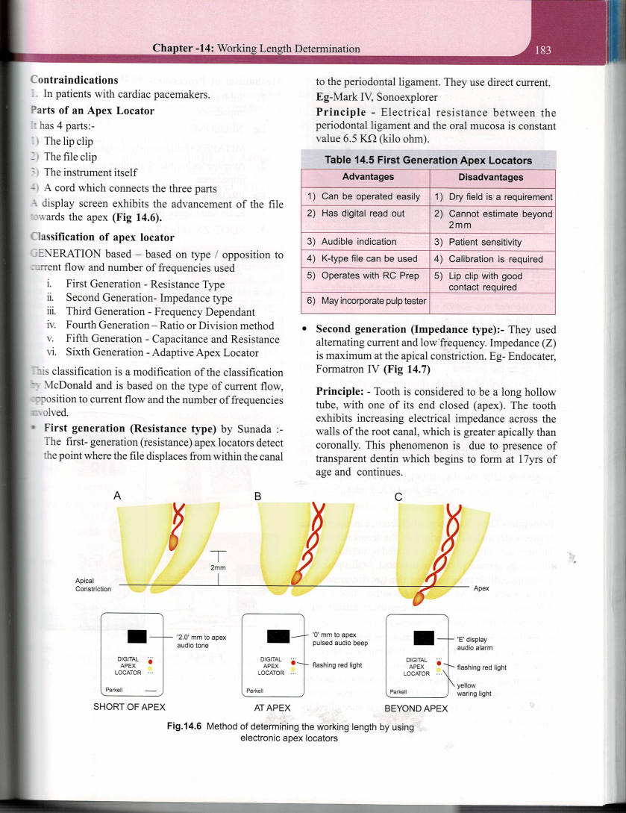

Parts of an apex locator
4 parts
Lip clip
File clip
Instrument itself
Cord that connects the three parts
A display screen exhibits the advancement of the file towards the apex

Slide 45
TERMINOLOGIES
Direct current (DC ) – Fixed amount of current per unit of time
Alternating current (AC) – The amount of current that alternates with time
Resistance – Opposition to direct current is called resistance (R)
Impedance – A circuit that has both capacitors & resistors . The total amount of opposition to an alternating current is called impedance (Z)
Capacitor – A structure of two conductive materials with an insulator between them forms an electric device called a capacitor
Capacitance – The amount of charge that a capacitor can store

Slide 46
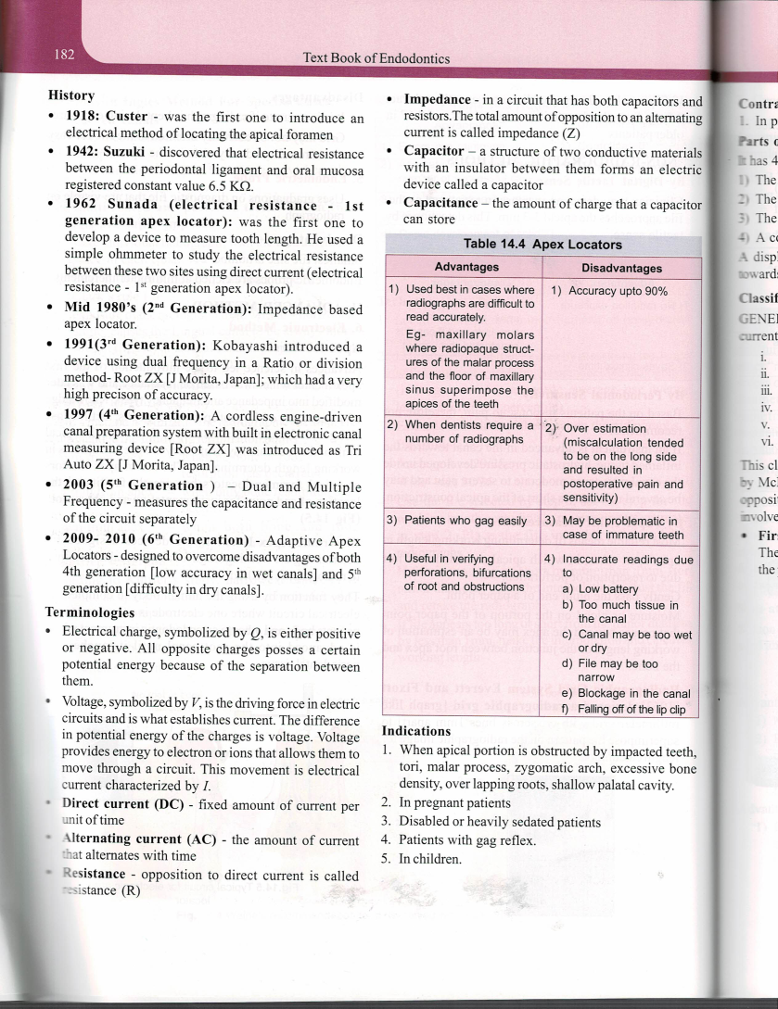

Slide 47
INDICATIONS OF APEX LOCATORS
Detect horizontal fractures.
Confirm periodontal or pulpal perforations.
Recognize any connection between the root canal & periodontal membrane such as root fracture, cracks & internal or external resorption.
Determine the location of root and pulpal floor perforations.

Slide 48
Contraindications of Apex locators
Intact vital tissue, inflammatory exudates & blood can conduct electric current & cause inaccurate readings so their presence should be minimized before accepting apex reading.
Canal shape, Lack of patency, the accumulation of dentine debris and calcifications can affect accurate working length determination with electronic apex locators.
Cardiac pacemaker patients

Slide 49
CLASSIFICATION OF APEX LOCATORS
Generations based – on type / opposition to current flow & number of frequencies used
First Generation – Resistance type
Second Generation - Impedance type
Third Generation – Frequency Dependent
Fourth Generation – Ration / Division method
Fifth Generation – Capacitance & Resistance
Sixth Generation – Adaptive Apex locator
This classification is a modification of the classification by Mc Donald & is based on the type of current flow , opposition to current flow & the number of frequencies involved

Slide 50
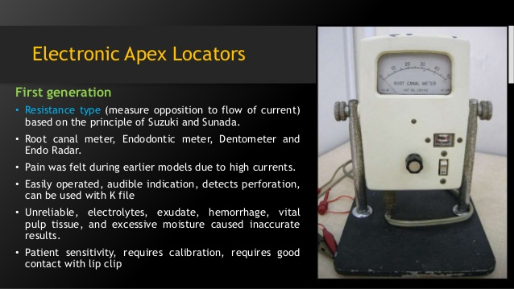
First generation – ( resistance type)
By Sunada
APL - Detect the point where the file displaces from within the canal to the PDL .
Use direct current e.g., Mark IV , Sonoexplorer
Principle
Electrical resistance between the PDL & the oral mucosa is constant – value 6.5 kilo ohm

Slide 52
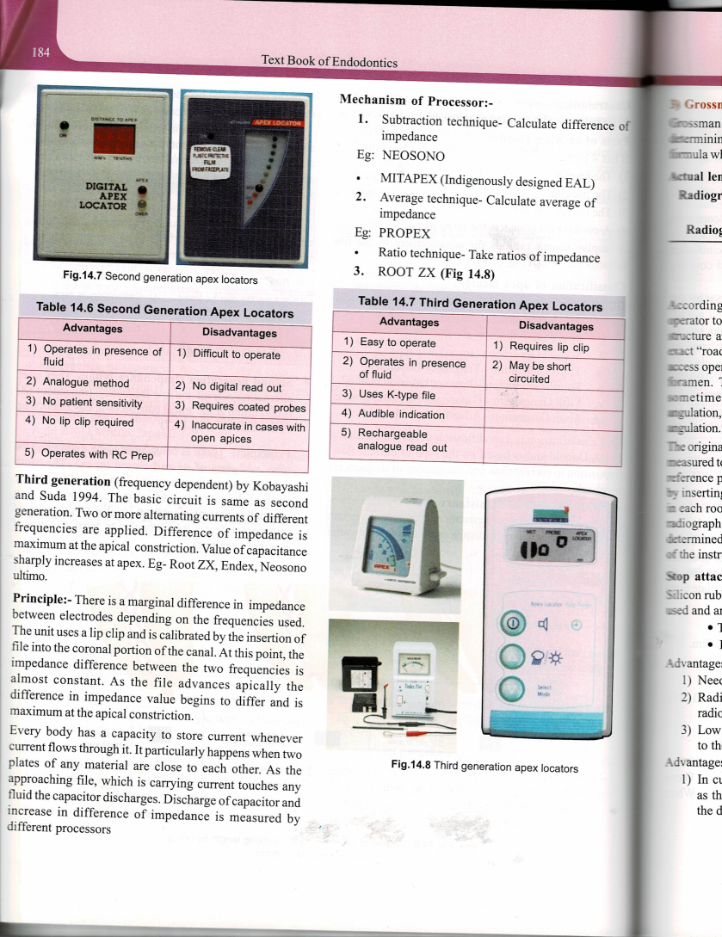
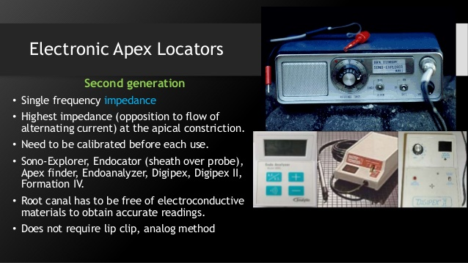
SECOND GENERATION
IMPEDANCE apex locators.
Principle: Measures opposition to flow of alternating current (or) impedance.
Examples: Endocator was an example of impedance type apex locator. Here high frequency (400 KHZ) current used.
This device uses large file with Teflon sheath.

Slide 53
DRAWBACKS
Teflon sheath coated file was difficult to use in narrow canals.
Got peeled off in canals.
Affected by autoclaving.
Patient uncomfortable due to high current used.
Calibration had to be done before using device.

Slide 55
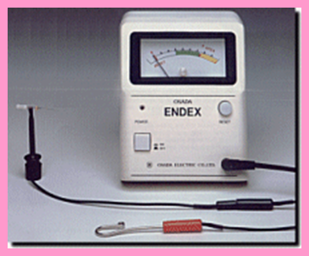
3rd generation apex locators
Are similar to 2nd generation except that they use multiple frequencies to determine distance from end of canal.
Impedance of given circuit may be substantially influenced by frequency of current flow, these devices are called frequency dependent.
Ex: Endex, Root ZX, Triauto ZX

Slide 56
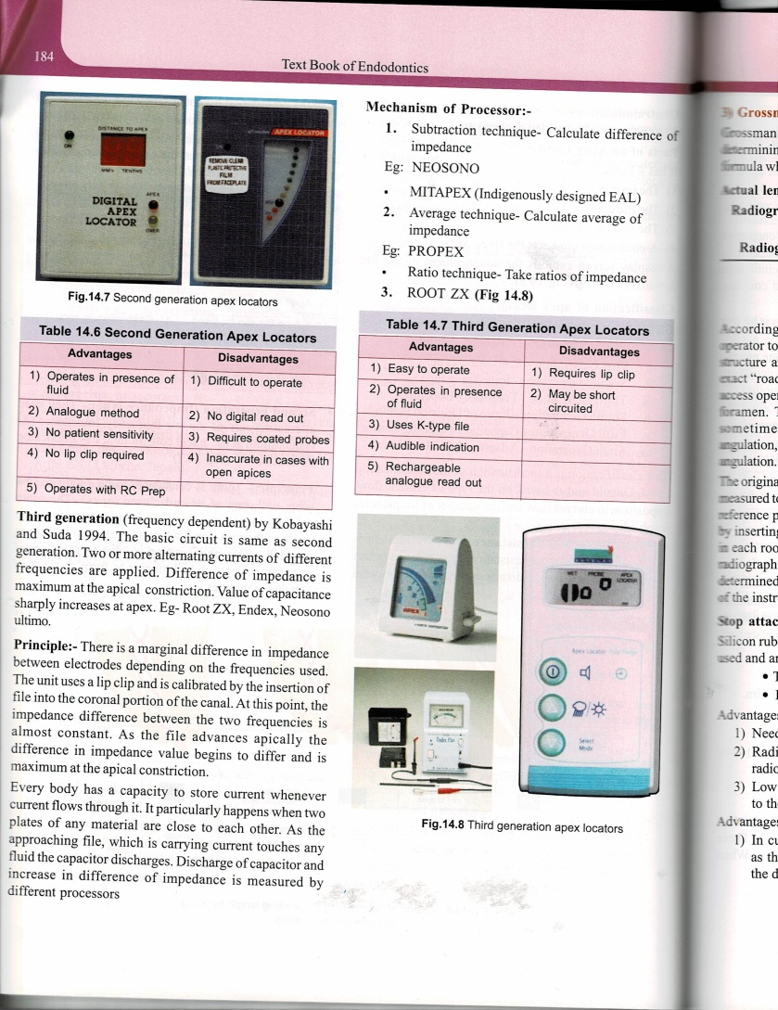
Mechanism of processor
Subtraction technique – calculates difference of impedance e.g., NEOSONO , MITAPEX( indigenously designed EAL )
Average technique – calculates average of impedance , e.g., PROPEX ,
Ratio technique – take ratios of impedence , e.g., ROOT ZX

Slide 58
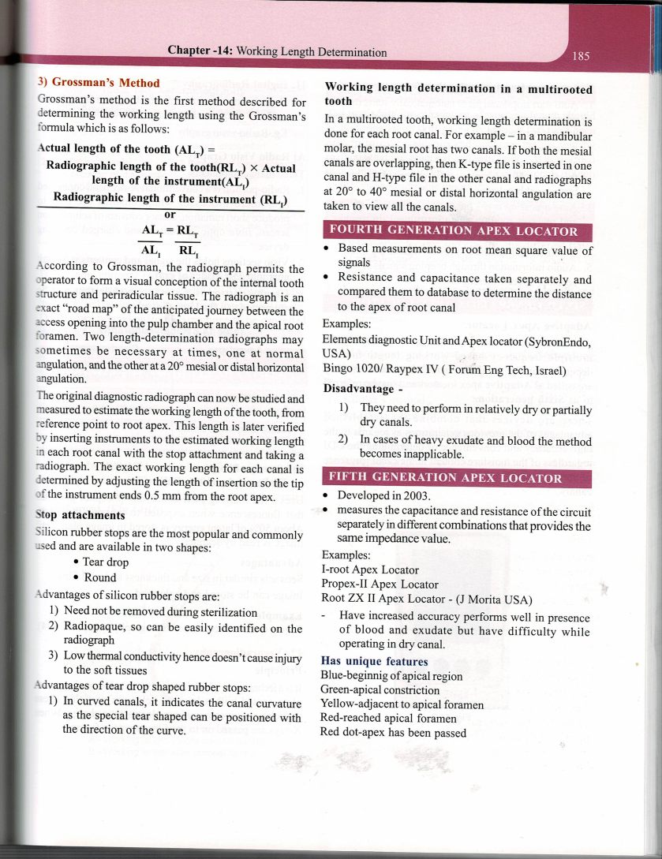
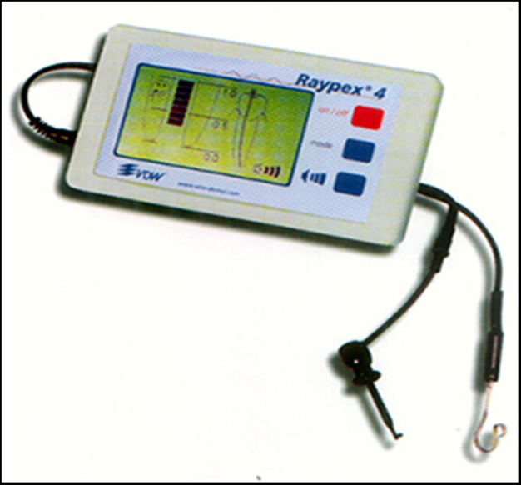
Fourth generation apex locator
Based measurements on root mean square valve of signals
Resistance & capacitance – taken separately & campared them to database to determine the distance to the apex of root canal
Examples

Slide 59
Fifth generation
Developed -2003
Measures the capacitance & resistance of the circuit separately in different combinations that provides the same impedance valve
Examples

Slide 60
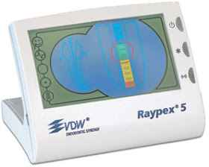



It has unique feature of apex zoom
4 blue – Beginning of apical region.
3 green – Apical constriction region
2 yellow – Adjacent to apical foramen
1 red – Reached apical foramen &
Red dot – Apex has been passed.
Ex: RAYPEX 5

Slide 61
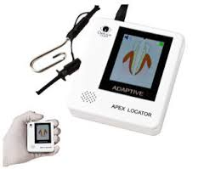

Sixth generation apex locators
Adaptive apex locators.
Multi frequency operative system.
High accuracy & convenience of determining the CDJ regardless of the moisture content in the canal ( presence of non- extirpated pulp , exudates, irrigants , dry / dried canal)
Ex- apex id

Slide 62
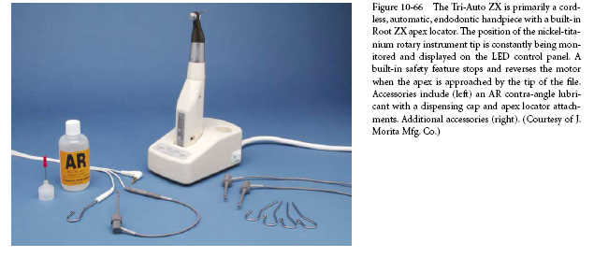
Combination Apex Locator and Endodontic Hand piece.
Tri Auto ZX
Has 3 automatic safety mechanisms
1. Auto start mechanism
2. Auto torque reverse mechanism
3. Auto apical reverse mechanism.

Slide 63
Newer apex locator with other features
Auto start stop – hand piece automatically starts rotation when instrument is introduced into the canal and stops when it is removed
Auto – torque reverse – hand piece automatically stops and reverses the rotation of instruments when the threshold (30gm/cm ) used is exceeded ( to prevent instrument breakage )
Auto – apical reverse – hand piece automatically stops & reverses rotation when instrument tip reaches a distance from the apical constriction
Colored multimedia display for measuring modes
Audio information through beeping signals / sensible speech messages

Slide 64
NEWER CONCEPTS IN TIMMING OF WL DERTERMINATION
Earlier – the cleaning of the root canal system was done followed by the flaring / shaping using step back technique
1ST , The coronal 2/3rd of the root canal system is flared – easier access of the root canal instrumentations to the apical 3rd – then cleaning is performed
RECENT CONCEPT

Slide 65
Important questions

